Slide 1

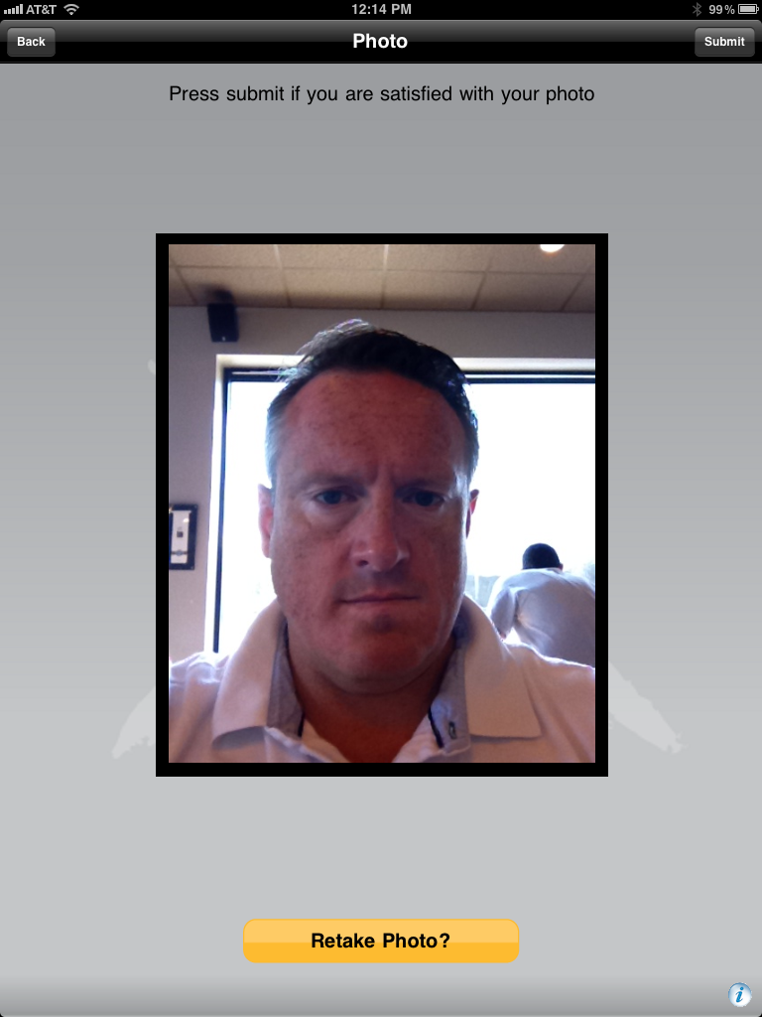

CONFIDENTID™ MOBILE PORTFOLIO Know Your Customer - Beyond a Shadow of Doubt℠
User Authentication Level
Todd Hawkins
Director, Business Initiatives 2013

Slide 2

CSC ConfidentID™ Mobile Portfolio
Using Mobility to secure the Mobile Channel, as well as, using the Mobile Channel to secure more traditional channels like: Logical, Remote & Physical Access
ConfidentID™ Mobile Know Your Customer (KYC)
User Authentication
Device Management
Application Protection
Location Intelligence
Data Protection
Network Services
Testing & Certification
Development
Cyber Security
Consulting

Slide 3
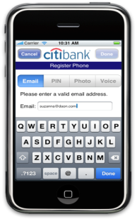


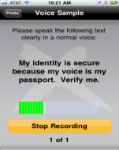
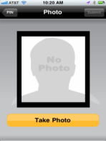
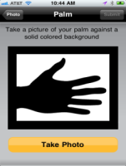
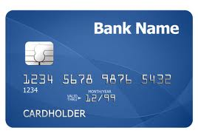
ConfidentID™ Mobile’s – Single, Most Critical Level to Know Your Customer (KYC)
Multi-Factor “In & Out of Band” Authentication
A Multi-Device Authentication Solution
Leveraging the latest generation smart phones and tablets (Apple, Blackberry, Android & Windows)
Solution Technology combining Multiple Authentication Techniques
Something you have (a smart phone), something you know (a PIN/passphrase), something you are (multi-modal biometrics – face, voice, palm), where you are (GPS)
Multi-Factor Fusion allows for Greatest Identity Accuracy
PIN/Passphrase
Biometrics – Voice, Face & Palm Image
Location Services – GPS, Cellular & M2M
Mutual PKI Authentication
Other factors as devices become enabled
=
We are placing biometric levels of identity assurance in to the hands of the consumers for the first time!
Without requiring costly, complex biometric devices, applications or system integration

Slide 4

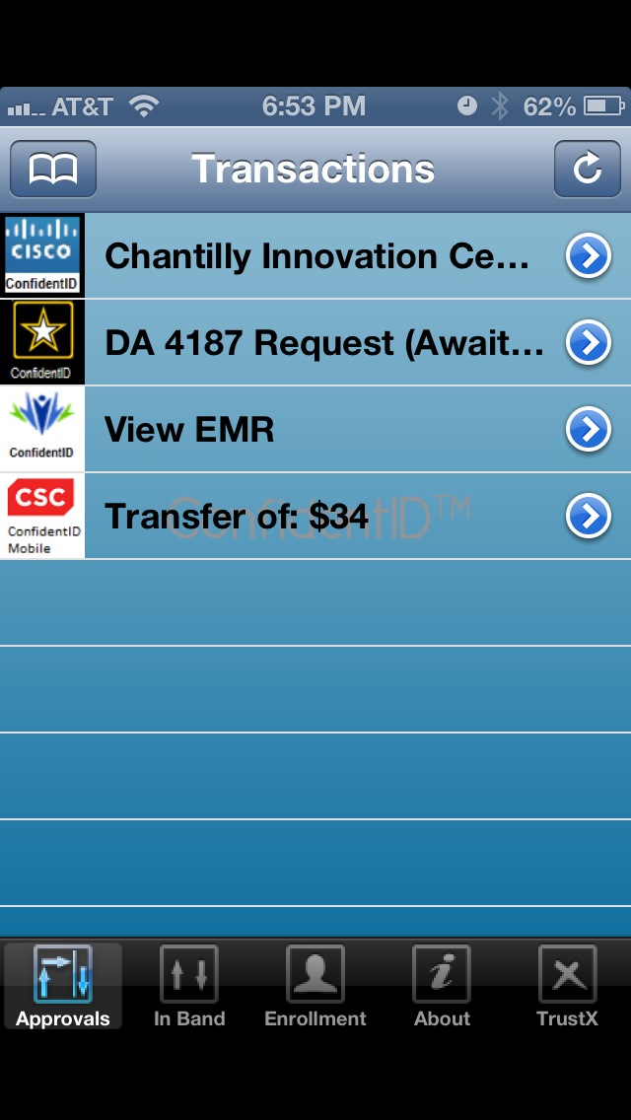
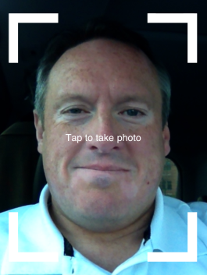
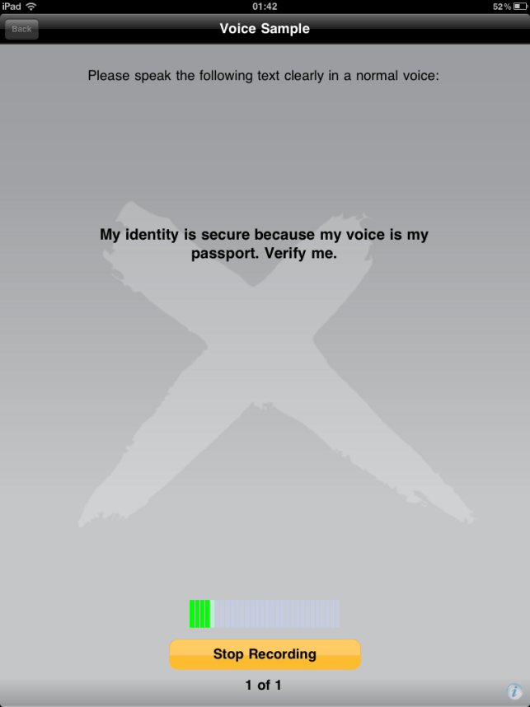
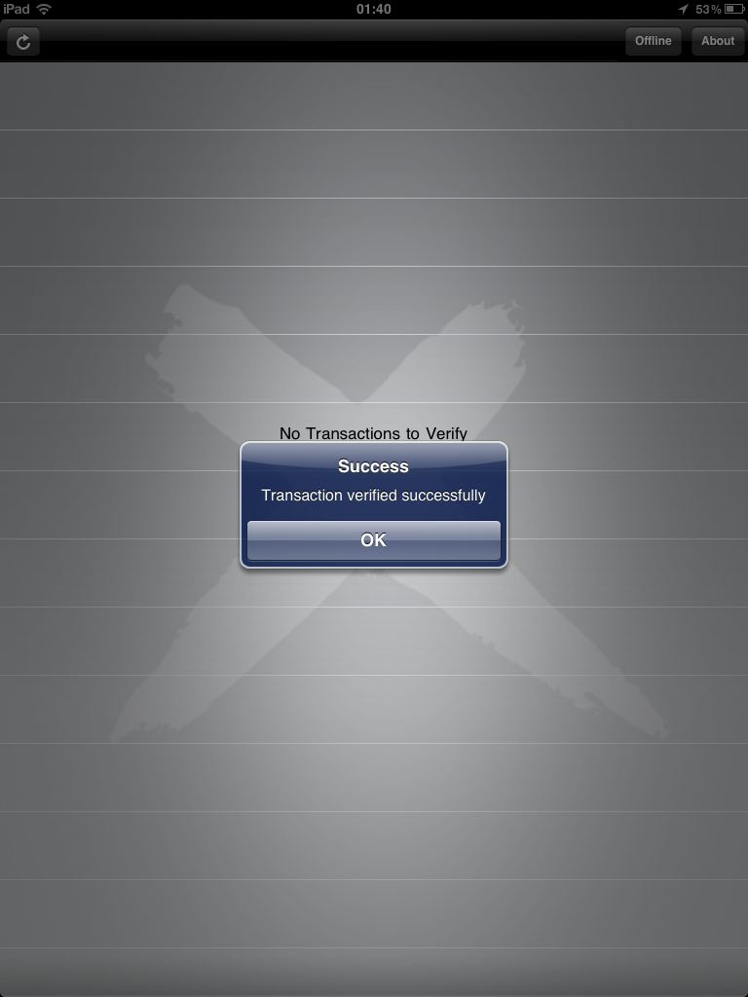
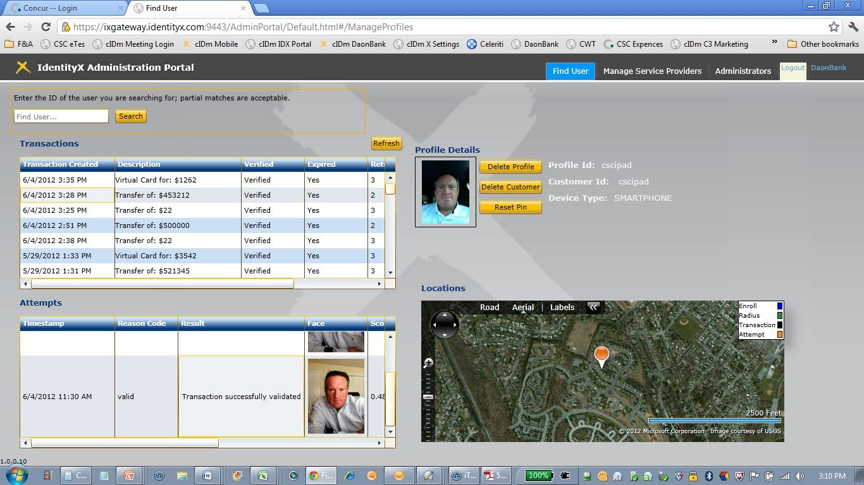
User Authentication – Over 11 Different Factors of Authentication

Slide 5
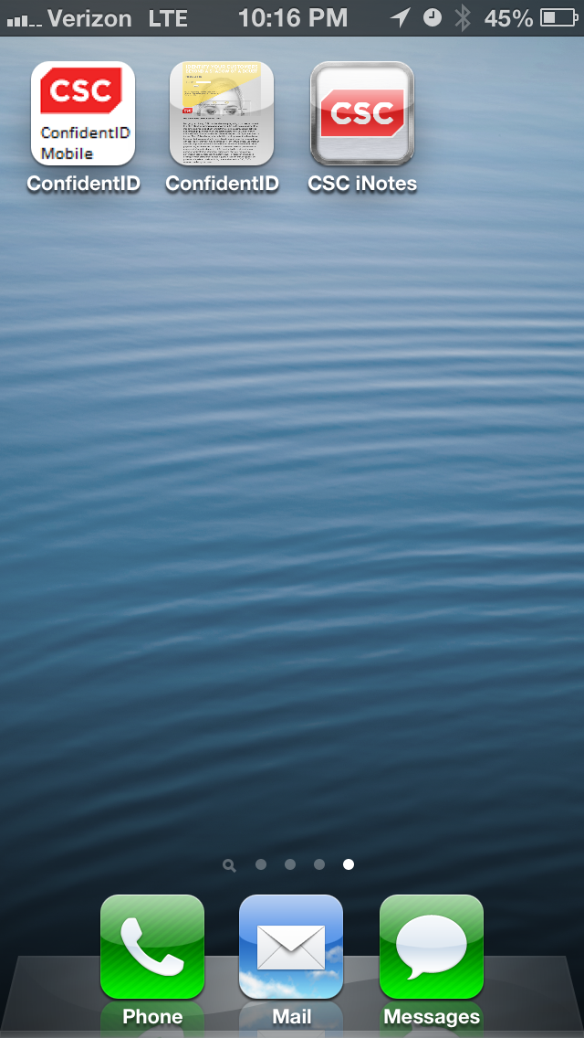
CSC ConfidentID Mobile App

Slide 6
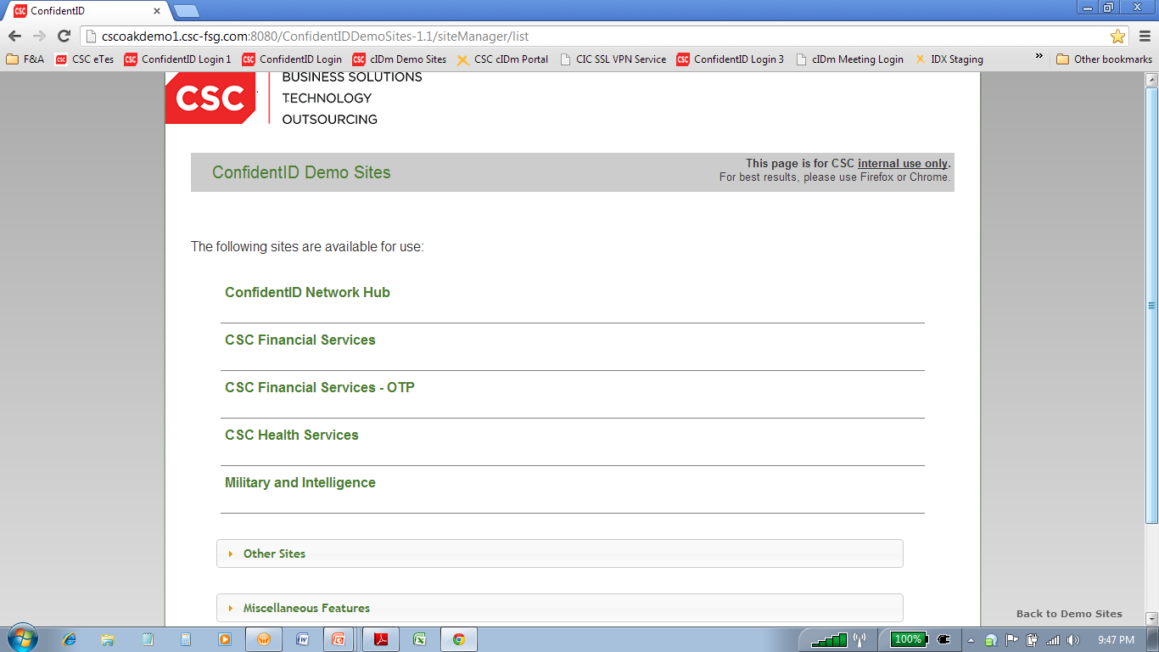
ConfidentID Network Hub

Slide 7
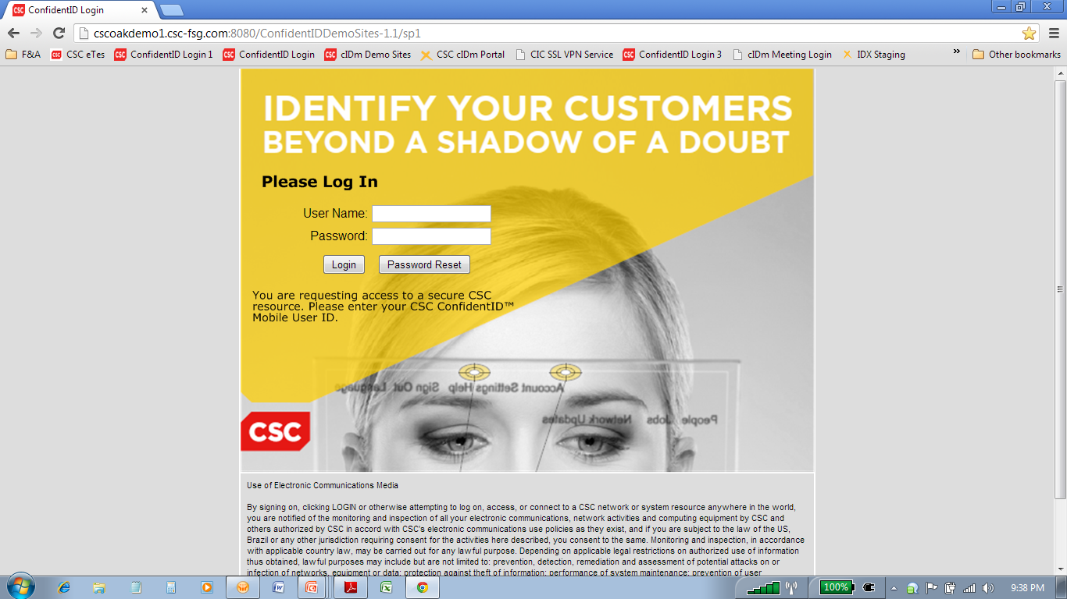
ConfidentID Mobile Password Reset

Slide 8
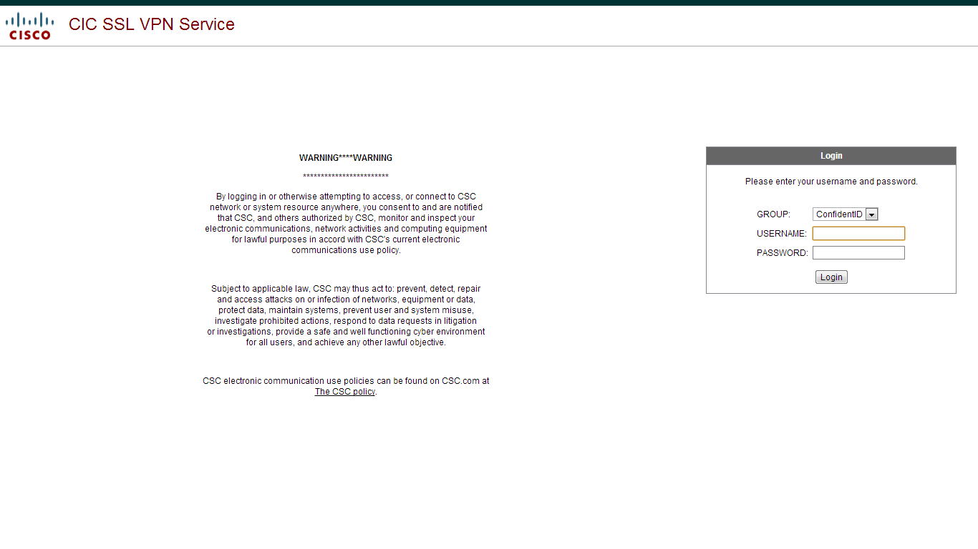
ConfidentID Mobile Cisco SSL VPN Service

Slide 9
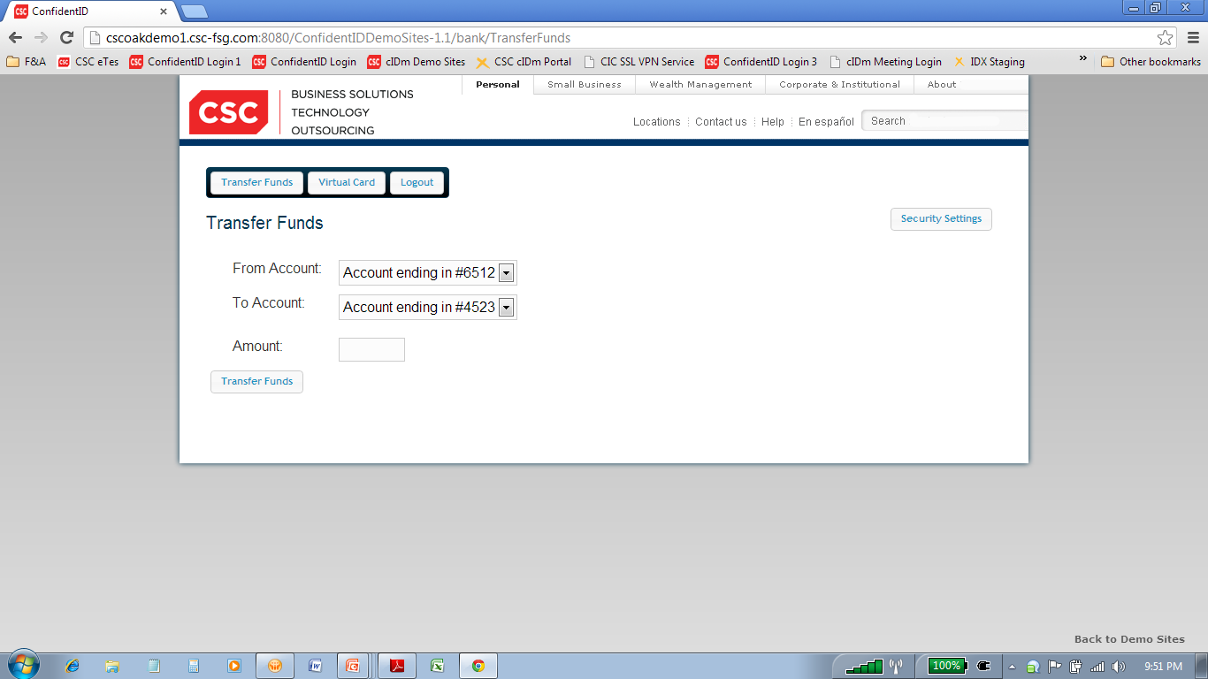
ConfidentID Mobile Banking Funds Transfer

Slide 10
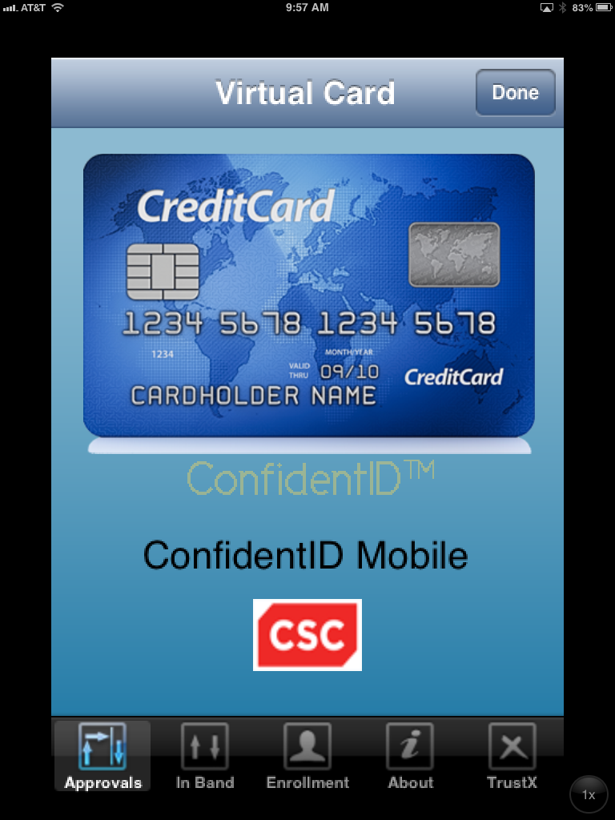
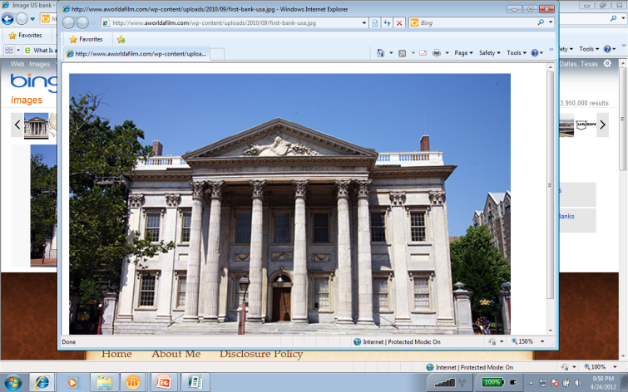
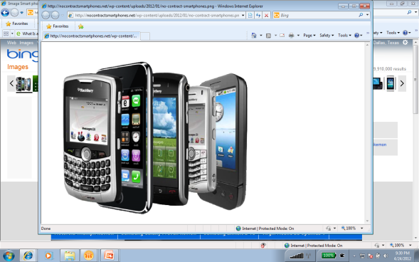
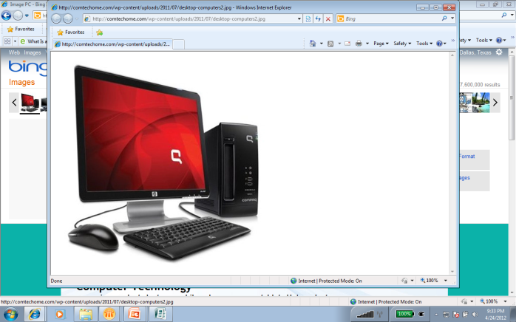
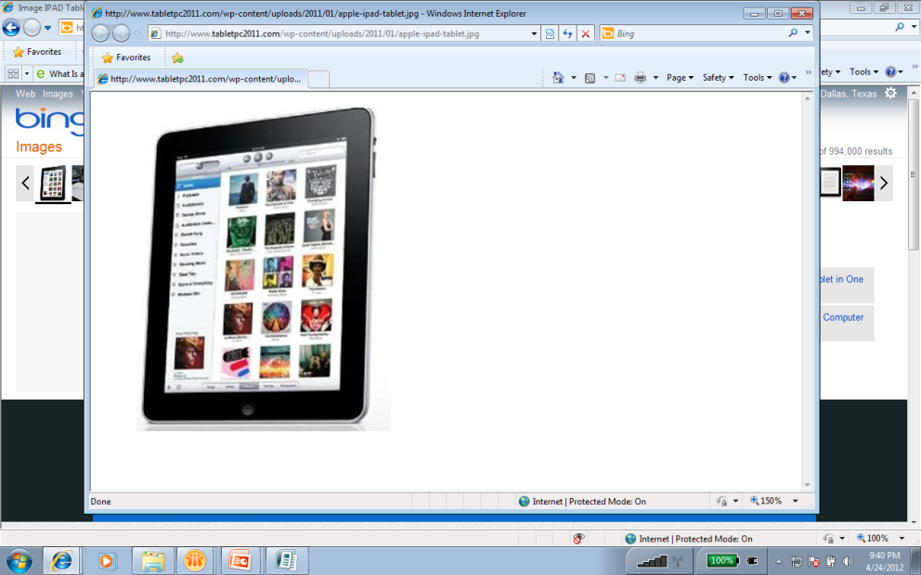
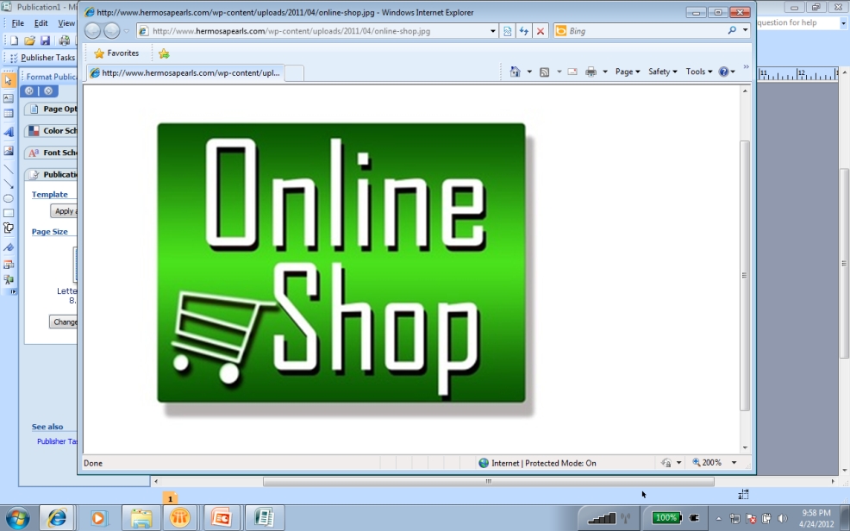
CSC’s Virtual Card Solution Use Case
Devices used for
Purchasing
Confident ID™ Mobile
Authenticate Cardholders Identity
CAMS II
Returns Virtual Card Information to Mobile Device
Cardholder’s
Bank
Cardholder Completes
Online Purchase using
Virtual Card
Online Merchant
CAMS II
Transaction Processing & Cardholder Billing

Slide 11
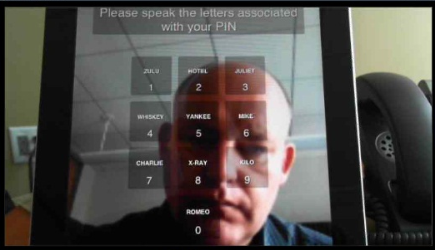
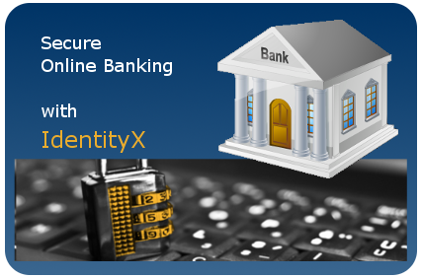
MePad
Dynamically Changing Visual PIN
Device Ownership
Voice Recognition with
Voice Liveness
Face Recognition with
Face Liveness
Location Intelligence
Mutual Authentication (PKI)

Slide 12
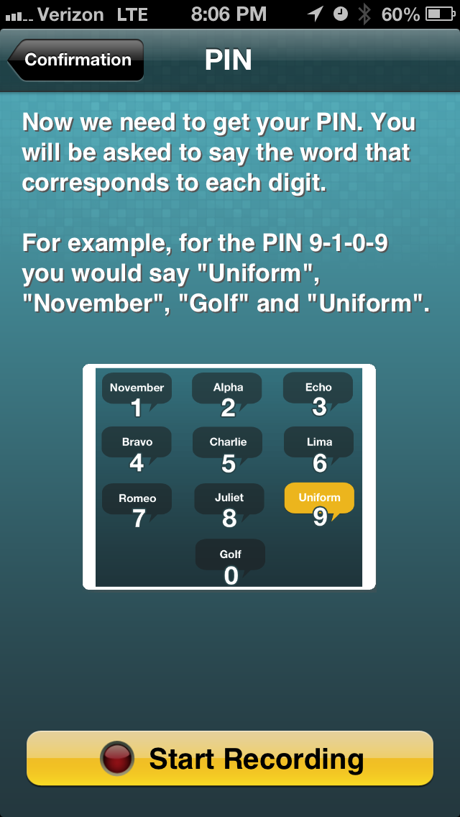
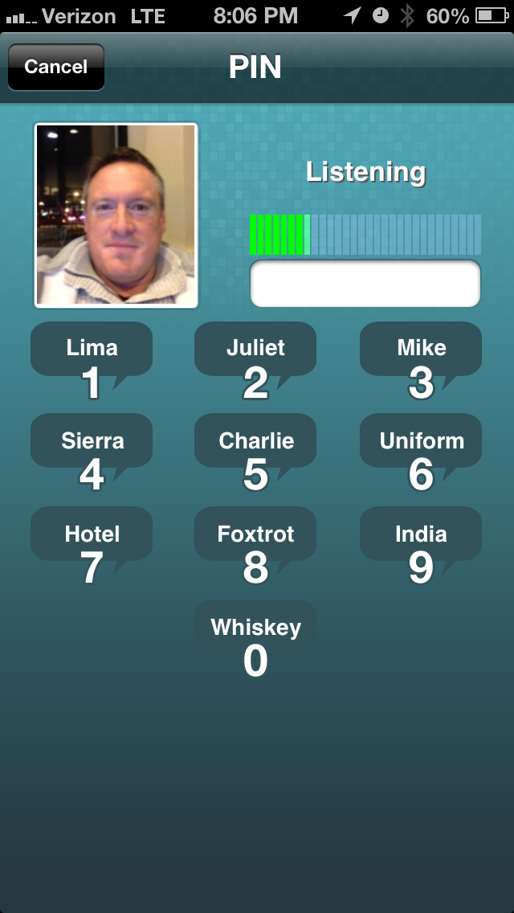
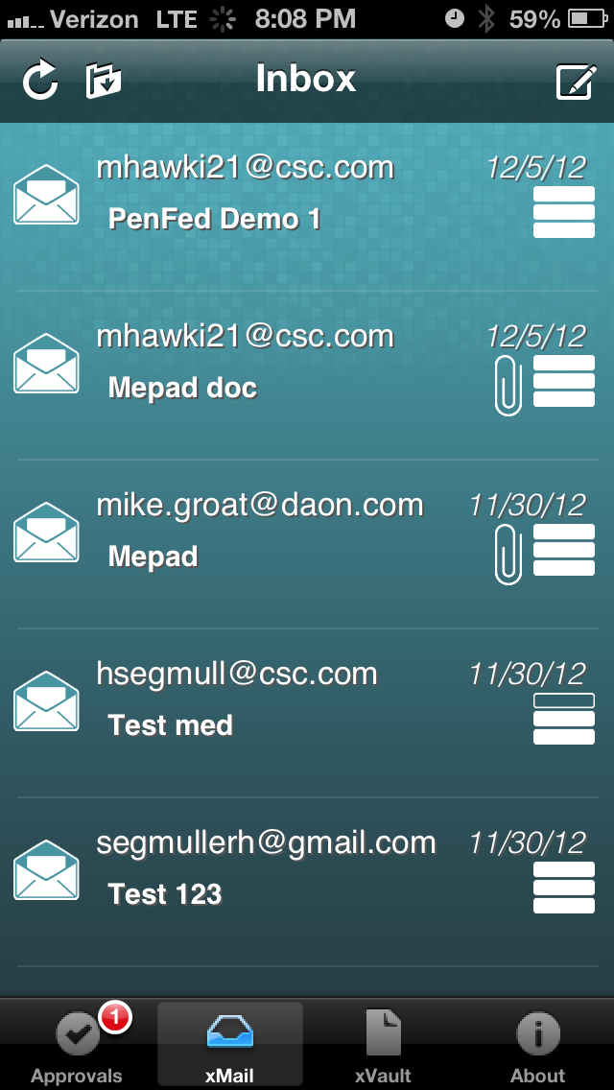
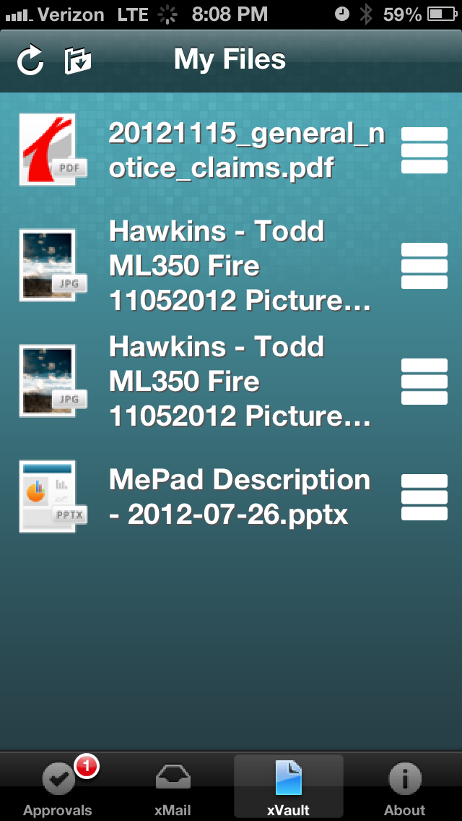
MePad Screens
Dynamic PIN
Face & Voice Liveness
Secure Email
Secure File Vault

Slide 13
ConfidentID Mobile Administrative Portal

Slide 14
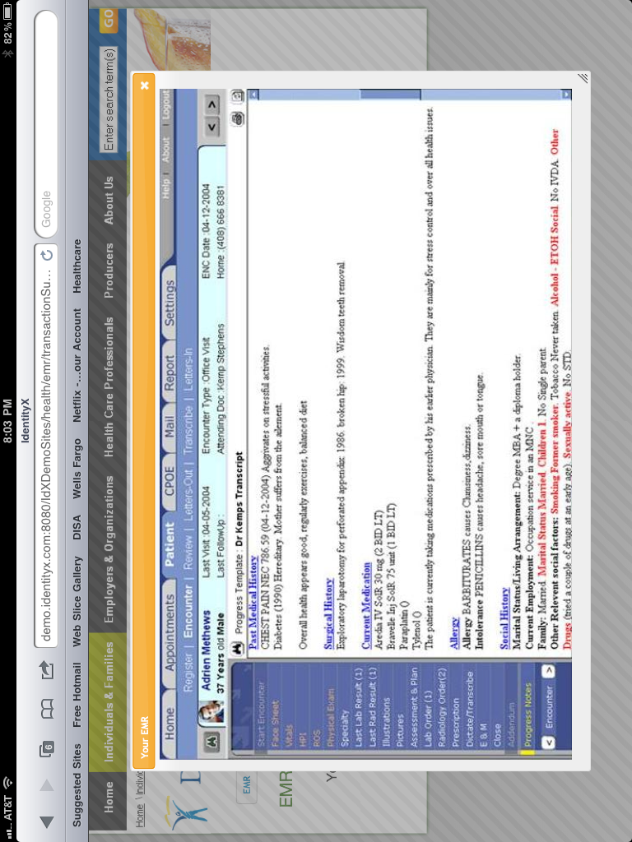
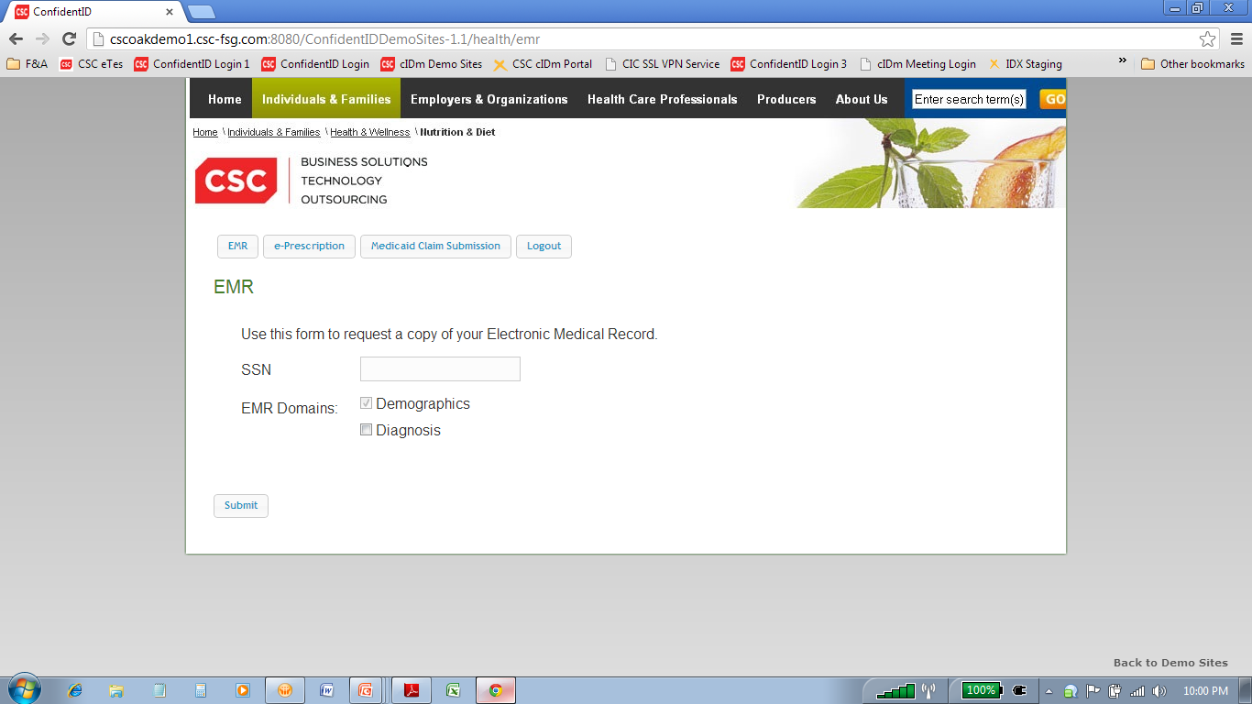
ConfidentID Mobile Healthcare Electronics Medical Record

Slide 15
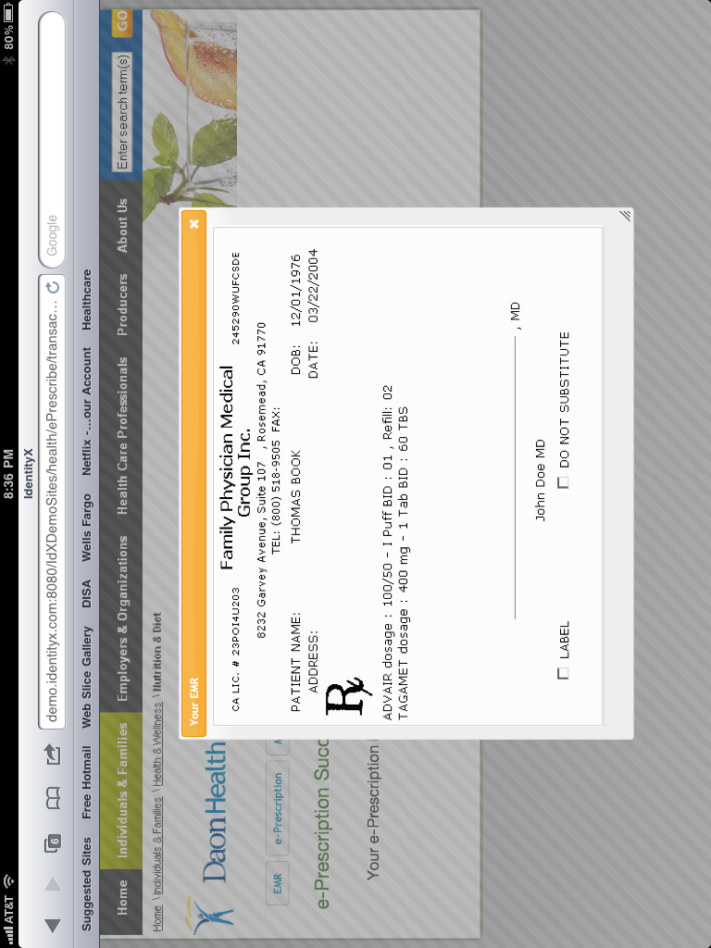
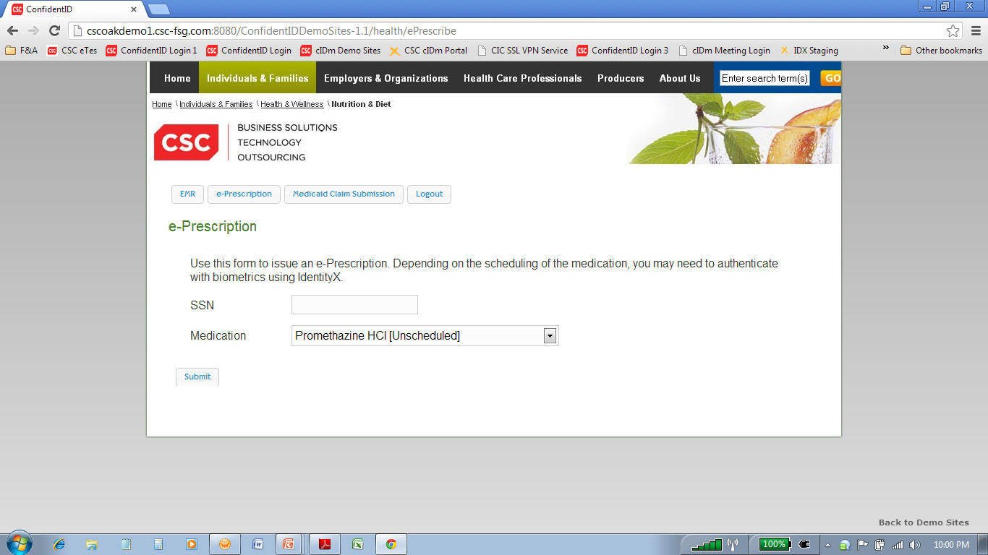
ConfidentID Mobile Healthcare e-Prescription

Slide 16
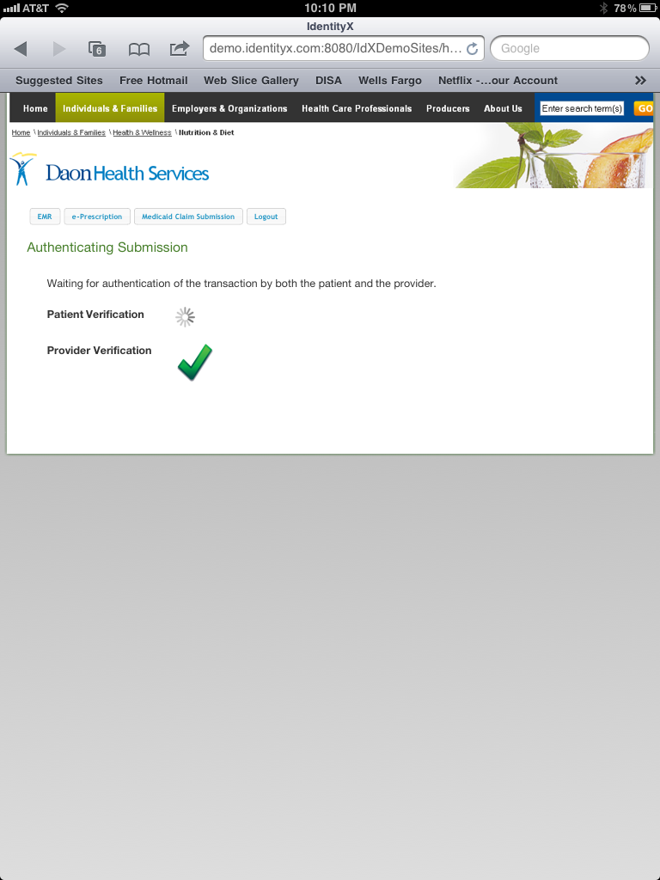
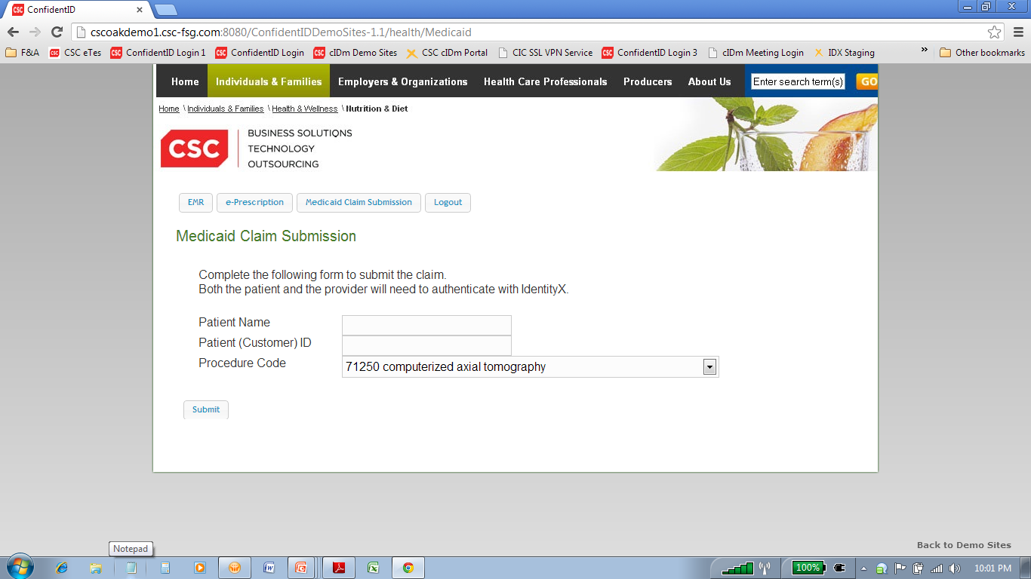
ConfidentID Mobile Healthcare Medicaid Claim Submission

Slide 17
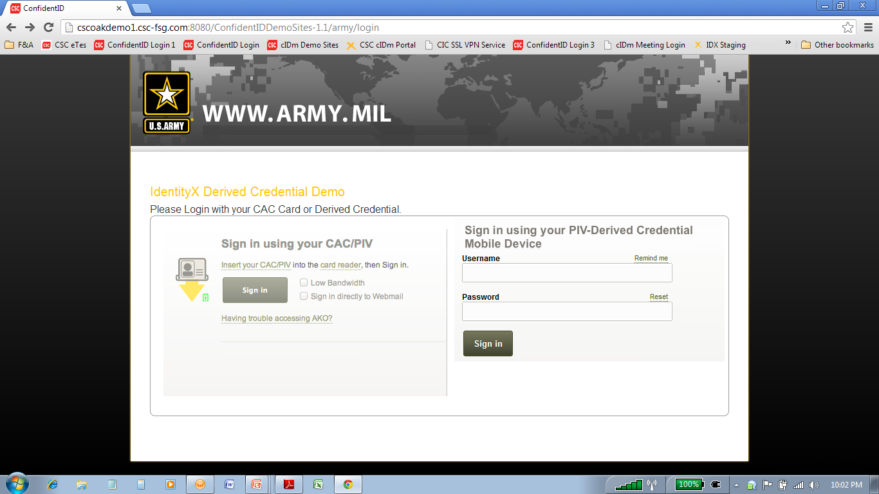
ConfidentID Mobile Government Derived Credential

Slide 18
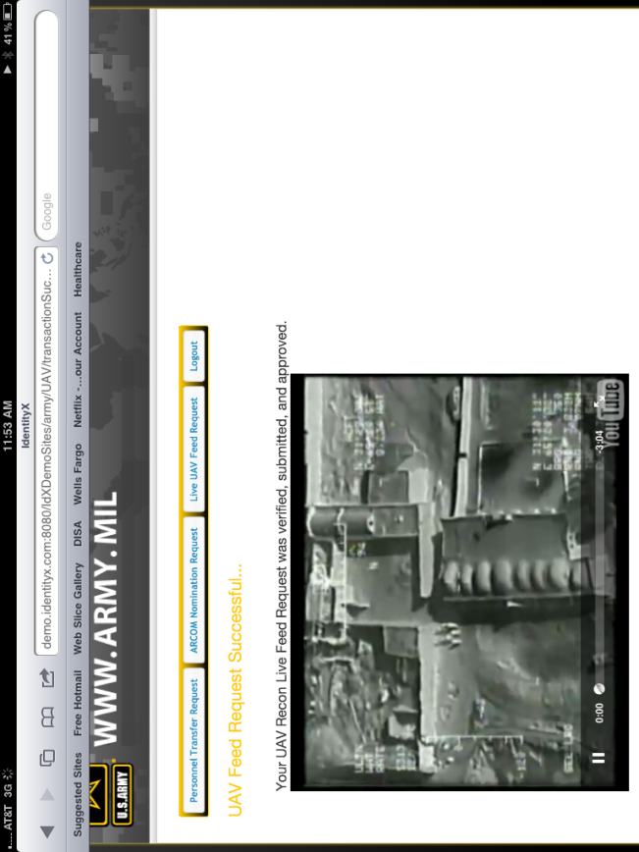
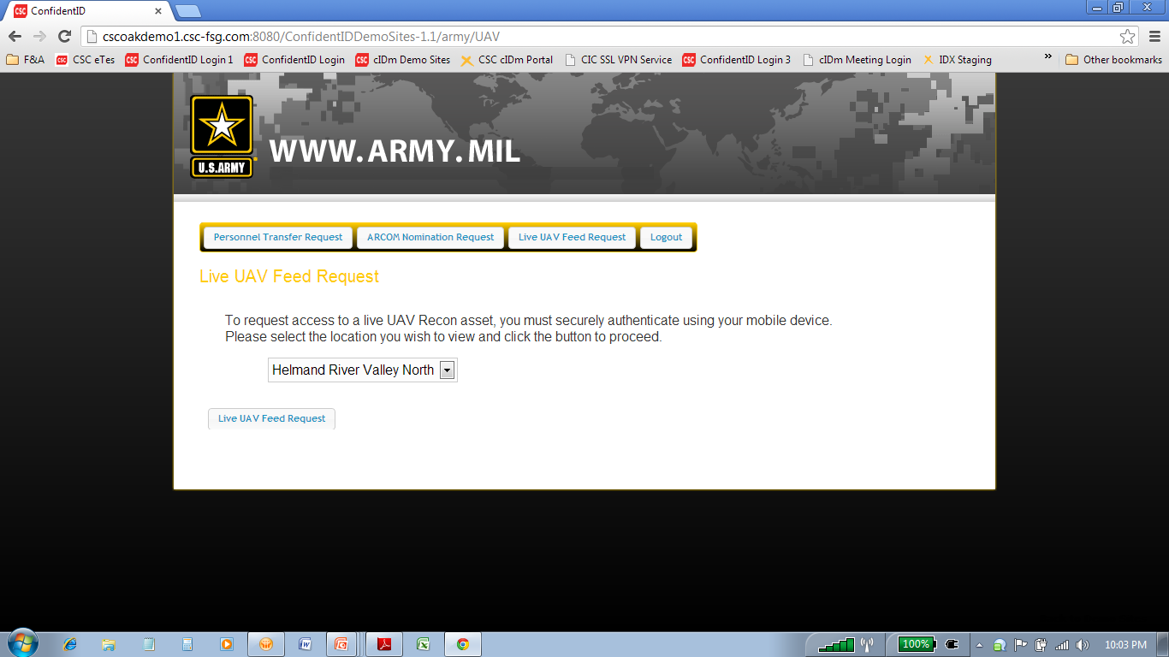
ConfidentID Mobile Government UAV Recon Feed

Slide 19
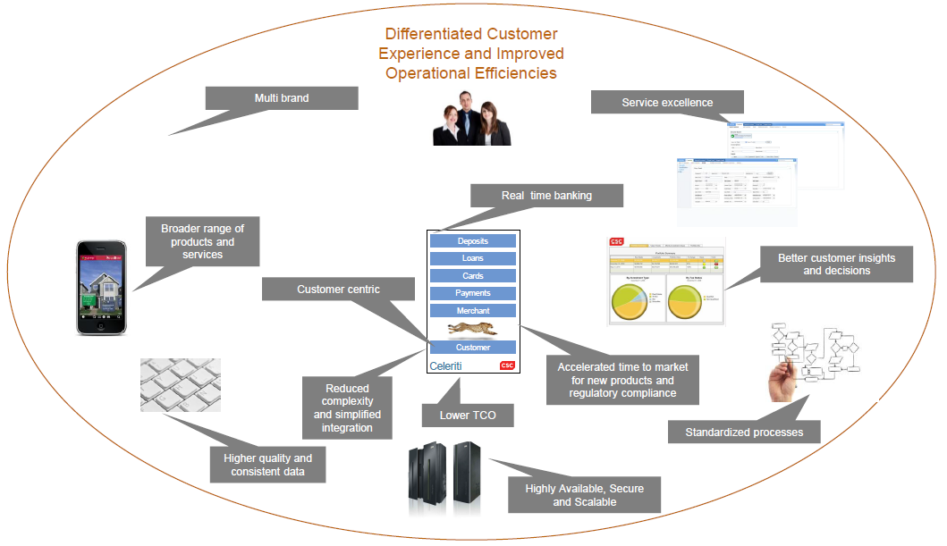
ConfidentID Mobile as part of Celeriti Banking Product
ConfidentID Mobile

Slide 20

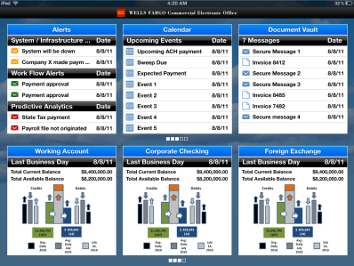
ConfidentID Mobile Single Sign On Dashboard
Consumer or Business User
Bring all Secured Apps in to a Single Dashboard
Multiple Financial Apps
Login in one then all will pull up
Put Banking, Healthcare & Insurance in one view
Include News, Social & Task Lists in one view
Business Example – CEO Mobile

Slide 21
ConfidentID Mobile Development Road Map
Current Feature Development:
MDM Layer - Good Integration into ConfidentID app
MAP Layer – Good and/or SAIFE Server Installation
Data Secure Layer - SAIFE Integration
Customizable Generic Bank Demo
MePad on CSC servers and iPhone app
Multilingual demos (French)
Multilingual demos (Spanish) Multilingual demos (German)
IES / Active Directory / Cisco VPN in Norwich
CA Siteminder
IES / F5 VPN
IES / Citrix Access Gateway - Complete
IdentityX admin portal - rebrand it.
Push Notification (iOS, Android, BB, Win, HTML(?))
Omnilocation integration
MePad w/ TrustX
ConfidentID Projects:
Digital Identity Authority cIDm Software as a Service Hosted Single Sign On Dashboard Celeriti (HTML5 Integration vs Native app)
ING POC
eVerify - Demo a use case I-9
Updated Healthcare demo
Global Pass POC iNotes Frontend POC
Appcelerator Integration
Mobile Device Management (MDM) integration
Mobile Insurance Application
Austrailian Army Demo
SAP CRM integration
FSG Demo Page of all FSG demos - not just cIDm

Slide 22
CSC’s Position
Mobile devices provide simple ‘biometric” capability which is leveraged by CSC’s ConfidentID Mobile solution to uniquely identify any customer or employee at all times
Mobile IS the MOST secure channel for conducting banking due to the ability to know your customer and what they are authorized to do at all times by:
Identifying hardware device by serial number
Identifying the authorized mobile network service by service electronic serial number (ESN)
Identifying the customer by using the “biometric” capabilities of the smartphone
Identifying the location of the customer and device at all times via GPS
Identifying the specific features, transactions, relationship and functions that customer (or employee) can use at any time
Single, re-usable solution for all customers, employees, devices, sessions and transactions ACROSS ALL CHANNELS
CONFIDENTID MOBILE

Slide 23


